Slide 1
Rate Types for Stream Programs
Thomas W. Bartenstein
Yu David Liu
State University of New York (SUNY)
at Binghamton
OOPSLA 2014
Notes:
17-18 minutes for talk, 4-5 minutes for questions

Slide 2
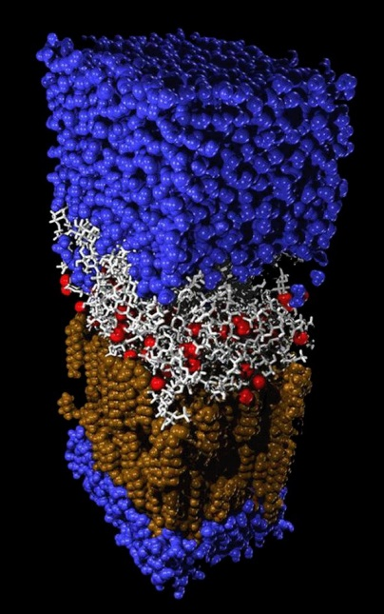
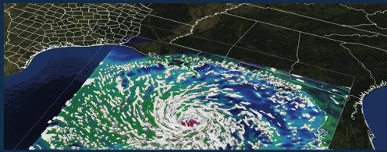
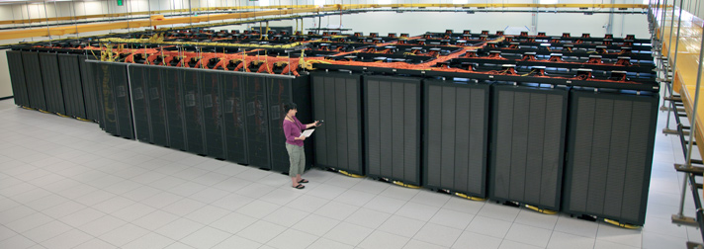
Data Intensive Applications
On the rise
High-performance requirement
Notes:
We’ve all seen the growth of data intensive computing applications with high performance requirements, such as smart-phone app servers, financial market modeling, DNA sequencing, CGI, etc. etc., which leads to the question…

Slide 3
Motivating Question
Can program structures help understand and optimize performance of data-intensive software?
Notes:
What do we mean by “performance”?
What kinds of performance question should we ask?

Slide 4
Performance Question 1
Is this data rate achievable and sustainable?
?

Slide 5
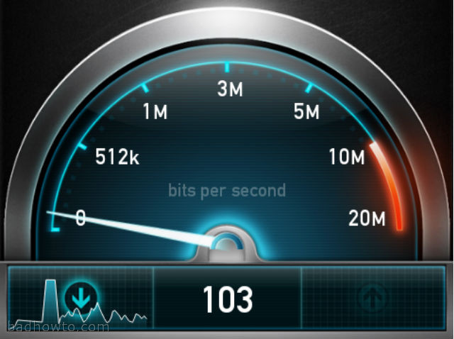
Performance Question 2
Given an Input data rate, what will the output rate be?
?

Slide 6
Performance Question 3
Given a desired output rate, what input rate is required?
?

Slide 7
Performance Question 4
Given unlimited Input data, how fast can the output rate be?
?

Slide 8
Rate Types
A type system to reason about data rates
in data intensive applications

Slide 9
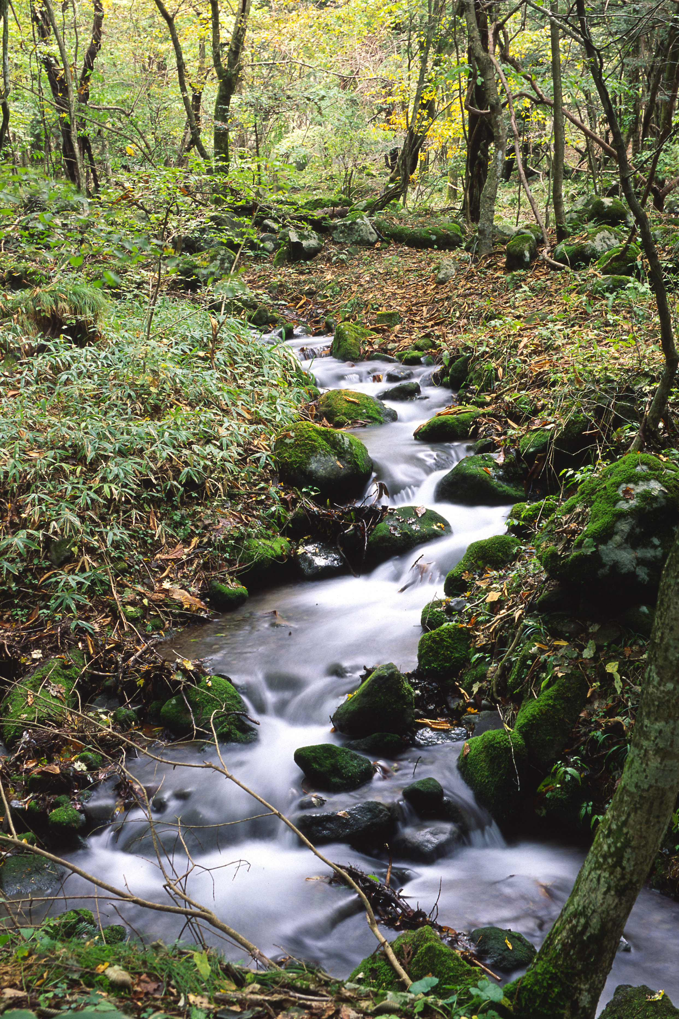
Motivating Question
Can program structures help understand and optimize data rate in data-intensive software?
Stream Programming
Notes:
We chose Stream programming--- why? …

Slide 10
Stream Programming Benefits
Friendliness to Big Data Applications
High Parallel Efficiency Task Parallelism, Data Parallelism, and Pipelining
Programming Constructs Conducive to Data Oriented Analysis
Notes:
Apply to big data crunching, streaming media, internet apps, smart phone apps, ….

Slide 11
Rate Types
A type system to reason about data rates of stream programs
Notes:
How do we start to understand stream processing rates?

Slide 12
Stream Rate Insight
Output Data rate depends on input data rate…
Notes:
… even when we speed up the input rate …

Slide 13
Stream Rate Insight
… until …

Slide 14
Stream Rate Insight
… input rate is faster than processing time;
Output rate is proportional to processing time.
Notes:
When that happens output rate is related to processing time

Slide 15
Input / Output Rate Graph
Where does it plateau?
What’s the slope?
Notes:
Example from single filter
Rate type characterizes input/output graph
Generalize to arbitrary stream graphs!
Theta is slope while output<nu starting at (0,0), nu is upper bound on output rate

Slide 16
Rate Types
Slope is the “throughput ratio” -
ratio between the output rate and input rate
Plateau is the “natural bound” -
output rate given unlimited input rate
Rate type is the tuple –

Slide 17
Input / Output Rate Graph
ν = 3
θ = 1
Notes:
Example from single filter
Rate type characterizes input/output graph
Generalize to arbitrary stream graphs
Theta is slope while output<nu starting at (0,0), nu is upper bound on output rate

Slide 18
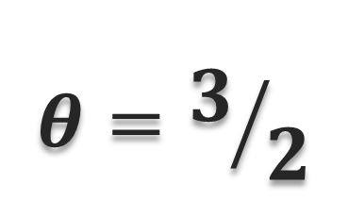
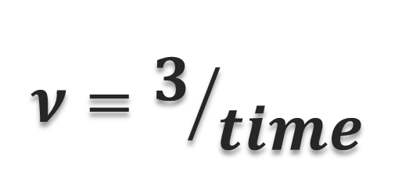
Single Filter Type Check
2
3
filter
time
$$θ=3/2$$
$$ν=3/{time}$$
Notes:
Filter – elementary unit reads/processes/writes
In this example, filter consumes 2 data items, and writes 3 data items in time
Profile to get time
Throughput ratio is:
Natural rate is:

Slide 19
Stream Programming: Combinators
chain
diamond
circle
Notes:
Combine filters…
Combine sub-graphs… compositional graph construction
Don’t go too long
Note splitter and joiner pseudo-nodes

Slide 20
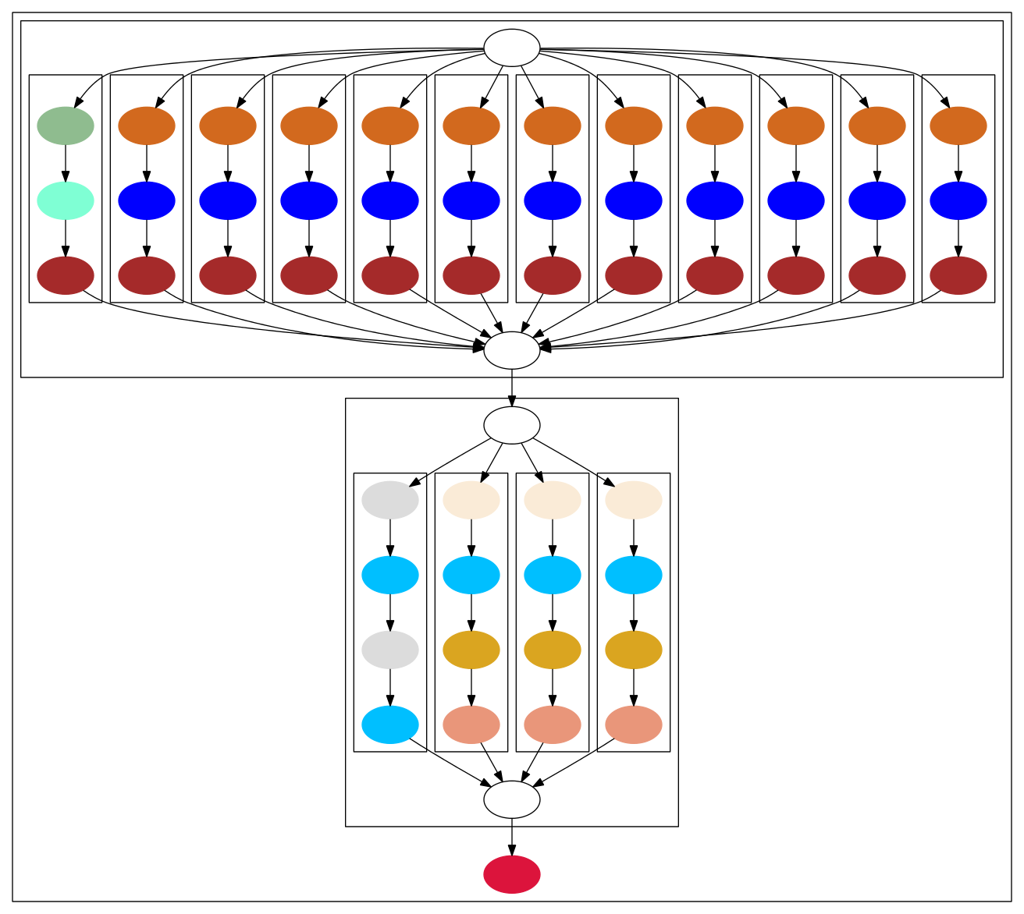
Data Rate Reasoning
Data rates of program dataflow paths can be reasoned about
Notes:
Stream applications built up from complicated stream graph whose nodes are filters (as well as splitters and joiners)
Example is “BeamFormer” benchmark

Slide 21
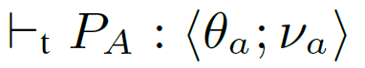

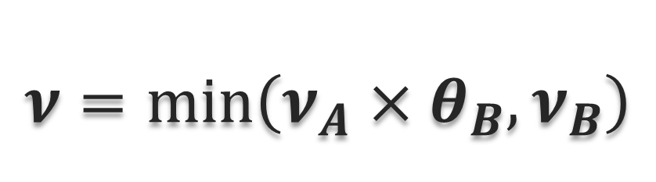
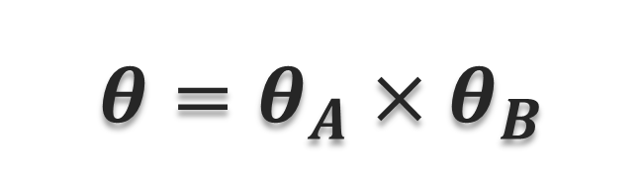
Chain Combination Type Check
P_{a}
P_{b}
$$θ=θ_{A}×θ_{B}$$
$$ν=\min_{}\left(ν_{A}×θ_{B},ν_{B}\right)$$
Notes:
Assumes sub-graph A types… and sub-graph B types…
Then, the throughput ratio to get through both A and B are…
And the natural rate is…

Slide 22
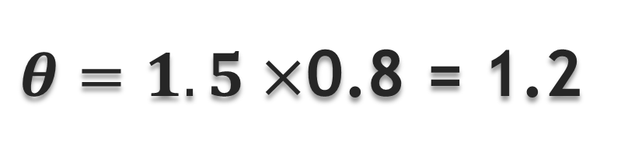
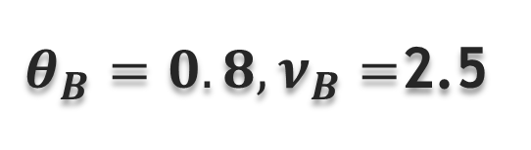
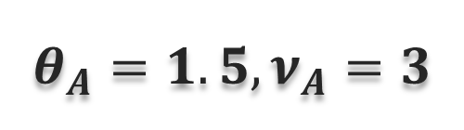
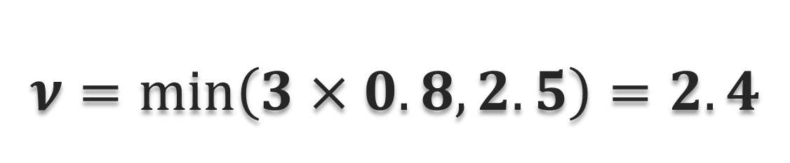
Chain Combination Type Check
$$θ_{A}=1.5,ν_{A}=3$$
$θ_{B}=0.8,ν_{B}=$2.5
P_{A}
P_{B}
$θ=1.5×$0.8 = 1.2
$$ν=\min_{}\left(3×0.8,2.5\right)=2.4$$
Notes:
Assumes sub-graph A types… and sub-graph B types…
Then, the throughput ratio to get through both A and B are…
And the natural rate is…

Slide 23
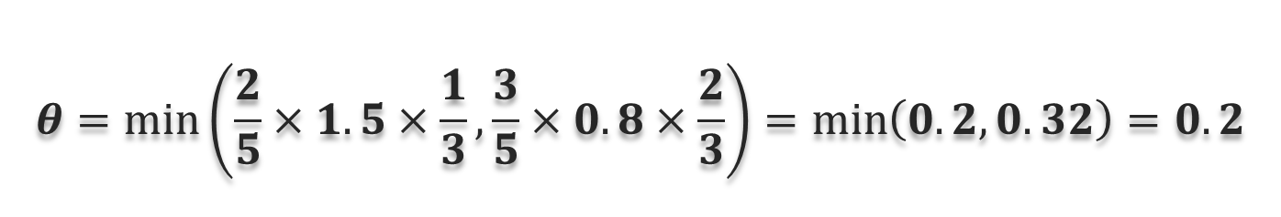
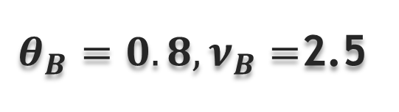

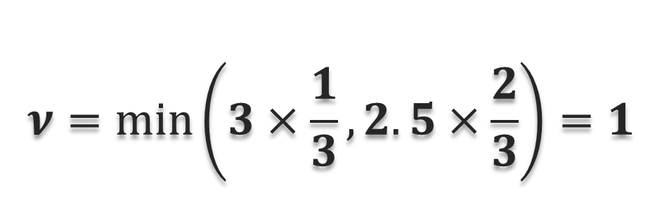
Diamond Combination Type Check
5
$$θ_{A}=1.5,ν_{A}=3$$
2
3
$θ_{B}=0.8,ν_{B}=$2.5
P_{A}
P_{B}
1
2
3
$$θ=\min_{}\left(\frac{2}{5}×1.5×\frac{1}{3},\frac{3}{5}×0.8×\frac{2}{3}\right)=\min_{}\left(0.2,0.32\right)=0.2$$
$$ν=\min_{}\left(3×\frac{1}{3}, 2.5×\frac{2}{3}\right)=1$$

Slide 24

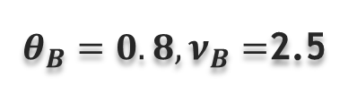
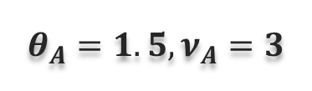
Circle Combination Type Check
$$θ_{A}=1.5,ν_{A}=3$$
Complicated because of feedback
Intuitively, inverted diamond
See paper for full details
$θ_{B}=0.8,ν_{B}=$2.5
1
1
2
$$ν_{A}^{′}=\min_{}\left(3,ν_{B}^{′}×2/1×1.5\right)$$
$$ν_{B}^{′}=\min_{}\left(2.5,ν_{A}^{′}×1/2×0.8\right)$$
$$ν=ν_{A}′×1/2$$
P_{A}
P_{B}
2
1
1
Notes:
Inverted diamond – join/split rather than split/join
Circular definitions – assume there is a solution – Fixed point
Nu_a’=min(3,3.6)=3 Nu_b’=min(2.5,1.2)=1.2 Nu=1.5

Slide 25
Data Rate Reasoning as a Typing Problem
Type Checking:
Type Inference:
Principal Typing:
?
?
?
?
Notes:
Given input and output rates is system achievable and sustainable?
Given input, is an output rate achievable? Given output, is input?
Given fixed or unlimited input, how fast is output?
Unify three motivating questions into a single type based solution

Slide 26
Subtyping
Notes:
Subtypes only when both theta and nu are less than supertype.
Intuitively, if I can achieve a rate on the top line, I can definitely achieve at least that rate on the sub-type.

Slide 27
Static/Dynamic Correspondence
Operational Semantics : Expressive & General
Supports Parallelism
Supports Arbitrary Schedules
No assumptions about synchronizing clocks
Soundness: if the type system says rate x can be achieved, a reduction sequence exists
Completeness: if the type system says rate x cannot be achieved, no reduction sequence with rate x exists
Notes:
Synchronizing clocks among filters
Soundness – there is at least one schedule which achieves rate x
Completeness – there are no schedules which achieve rate x

Slide 28
Rate Types Theoretical Results
Type inference is sound relative to type checking
Type inference is complete relative to type checking
Principal typing exists

Slide 29
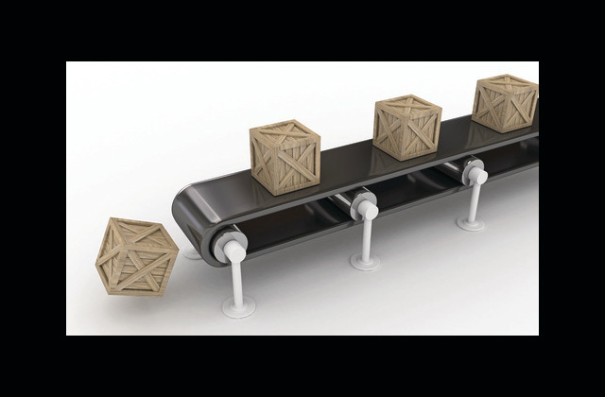
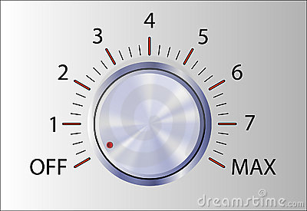
Implementation
StreamIt base
Calculate principal rate types
Control Input rate
Measure Output rate
Run benchmarks
4 Micro-benchmarks
6 StreamIt benchmarks
200 input data rates
Graph Expected vs. Measured
Notes:
Micro benchmarks are filter, chain, diamond, and circle

Slide 30
Results : FFT benchmark
Notes:
Fft 16 core – results for all benchmarks in the paper
Nu and theta are derived from constraints & filter profiles
Green line – actual (controlled input, measured output) I/O data rates

Slide 31
Rate Types Generality
Potential Generalizations to Systems such as Aurora, Bamboo, StreamFlex,…
Limitations include…
Assumes declarative push and pop counts for filters
Assumes stable filter level profiling
Current/Future work includes hybrid typing
handle dynamic fluctuations
improve adaptiveness
Notes:
More details are contained in the paper itself

Slide 32
Summary
Can program structures help understand performance of data-intensive software?
Rate Types: Unified solution to performance reasoning questions!
Notes:
Rate types answers a surprising variety of performance questions using primarily static type system reasoning!

Slide 33
Thank You
Notes:
Loops

Slide 34
Data Rates
Designed to answer questions such as:
How many items per second a program can produce when it is fed with x data items per second on input?
How many items per second a program needs to be fed on the input so that it can produce y data items per seconds on the output?
What is the fastest output rate a program can achieve, given unlimited input data rates?
Notes:
Make this graphical instead of words

Slide 35
Data Rate Infrastructure
Need an infrastructures which:
Is structured enough to support meaningful reasoning
Enables parallel reasoning
Is relevant
Stream Programming
Notes:
Start with…

Slide 36
Rate Types
A type system to reason about data rates of stream programs
Profile elementary units
Leave the rest to the type system!
Surprising how much we can statically answer questions that seem to be inherently dynamic

Slide 37
Stream Programming: Filters and Streams
x=Pop()
x=x+3
Push(x)
…, 28, 21, 14, 7
…, 31, 24, 17, 10
Streams:
Sequence of Data
Filters:
Consume data from an input stream
Process Data
Produce data on an output stream

Slide 38
Stream Rate: Insight (Scenario) 1
output rate is proportional to input rate
14
7
17
10
0.0
0.5
1.0
time
2 items/sec
2 items/sec
Notes:
Stream rates like gallons per minute flow through an oil pipeline.
Note that output is offset from input (by filter processing time)

Slide 39
Stream Rates: Insight (Scenario) 2
Scenario 2
output rate is bound by processing time!
21
28
10
17
14
24
7
0.0
0.5
1.0
time
4 items/sec
3 items/sec
Notes:
Basic assumption: Filter must finish processing old data before it can start on new data – no parallel execution of filters (without split/join)

Slide 40
Stream Operational Semantics
Track stream data items
Track filter/graph processing times
Enable parallel execution
Enable compositional semantic reasoning
Abstract machine with minimal assumptions:
Works without synchronizing clocks
Works with arbitrary schedules
Notes:
Move this later, and reduce….
graph state: # data items per stream
minimum time required for each state transition
Filter A and B can execute simultaneously if state allows
Treat A and B as sub-graphs instead of filters
Allows A then B, B then A, or A and B simultaneously
See paper for technical details
Supports Parallelism
No assumptions on inter-filter synchronization
Tolerates arbitrary schedules

