Slide 1
SCRAP:
Architecture for Signature-Based Protection from Code Reuse Attacks
Mehmet Kayaalp, Timothy Schmitt, Junaid Nomani, Dmitry Ponomarev and Nael Abu-Ghazaleh
Department of Computer Science
State University of New York at Binghamton
Presented at the19th IEEE International Symposium on
High-Performance Computer Architecture (HPCA-19), February 25th, 2013

Slide 2
Vulnerability Classification from NIST-NVD
*01/2010 – 12/2012 CVE Records (Severity 7 – 10)

Slide 3
Buffer Overflow and
Code Injection Attack: Example
0x0000
main (int argc, char **argv)
{
...
vulnerable(argv[1]);
...
}
vulnerable(char *str1)
{
char str2[100];
strcpy(str2,str1);
return;
}
malicious input
(str2)
str2
xor ecx, ecx
mul ecx
lea ebx, [esp+8]
mov al, 11
int 0x80
Stack frame for
vulnerable()
malicious return
return address
Stack frame for
main()
Stack
growth
0xFFFF

Slide 4
Existing Protection from Code Injection Attacks:
No Execute Bit (NX)
0x0000
Mark memory pages as
  Either WRITABLE
  Or EXECUTABLE
  But not both
Standard technique in current processors and operating systems
  Intel XD bit
  AMD XN bit
  Windows DEP
  Linux PaX
xor ecx, ecx
mul ecx
lea ebx, [esp+8]
mov al, 11
int 0x80
WRITABLE
NOT EXECUTABLE
malicious return
Stack
growth
0xFFFF

Slide 5
Next Frontier: Code Reuse Attacks (CRAs)
Key Idea: Reuse existing library code instead of code injection
Bypass NX
Return Oriented Programming
Jump Oriented Programming

Slide 6
Return Oriented Programming Attacks
Turing-complete
  X86
  SPARC
  ARM
Exploits
  Voting machine
  Atmel sensor
  Cisco router
  Xen hypervisor
  Jailbreak
  Pwn2Own
Automated tools
Microsoft BlueHat Prize ($260K)

Slide 7
Return Oriented Programming (ROP)
0x0000
<Address A>
<B>
<D>
<C>
xor ecx, ecx
ret
xor ecx, ecx
mul ecx
lea ebx, [esp+8] mov al, 11
int 0x80
mul ecx
ret
lea ebx, [esp+8]
ret
<Address B>
Stack frame for
vulnerable()
mov al, 11
int 0x80
Page marked as EXECUTABLE
<Address C>
malicious return
<A>
Stack frame for
main()
<Address D>
Stack
growth
0xFFFF

Slide 8
Jump Oriented Programming
0x0000
<Address A>
Dispatcher Gadget
<Address B>
<register values>
<C>
<D>
<F>
<E>
popa
jmp esi
xor ecx, ecx
mul ecx
lea ebx, [esp+8] mov al, 11
int 0x80
<Address C>
pop edi
jmp edi
xor ecx, ecx
jmp esi
Stack frame for
vulnerable()
mul ecx
jmp esi
<Address D>
Page marked as EXECUTABLE
lea ebx, [esp+8]
jmp esi
mov al, 11
int 0x80
<Address E>
malicious return
<B>
Stack frame for
main()
<Address F>
Stack
growth
0xFFFF

Slide 9
Defending Against JOP Attacks
Use solutions preventing buffer overflows
  Bounds Checking
  Information Flow Tracking
Ensure the legitimacy of jump targets at runtime
  {Abadi-05}: Control-Flow Integrity (USENIX Security)
  {Kayaalp-12}: Branch Regulation (ISCA)
Signature-based detection
  Detect the anomaly in control flow

Slide 10
Prior Work on Signature-Based Detection
“DROP: Detecting ROP malicious code”
  P. Chen et al. ICISS 2009
    if (# instructions between returns <= 5)
    then it is a gadget
    if (# consecutive gadgets >= 3)
    then it is a ROP attack

Slide 11
DROP
Consecutive Gadgets
CRAs
min # gadgets to launch a CRA
S=3
Regular workloads
max tolerable gadget length for CRA
Gadget Length
N=5

Slide 12
Building on DROP
Apply the same idea to
  Indirect jumps
  Indirect calls
Adjust the thresholds

Slide 13
Extending DROP for JOP
CRAs
Added dispatcher gadgets
Indirect jumps/calls are not that frequent
min # gadgets to launch a CRA
Regular workloads
max tolerable gadget length for CRA

Slide 14
Case of Long Gadgets
Side effects
  Overwrite registers/memory locations
  May cause exceptions
    adc [ebx-0x74EBDBAC], cl
  Limited number of registers
    One for the dispatcher
    One for jumping back to the dispatcher
    Only 6 left (in x86)

Slide 15
Gadget Length and State Changes

Slide 16
Defeating DROP
Make the attack pattern less predictable
  Perform some unnecessary computation
  Without harming attack state
Call a function
  Execute many instructions
  Return to the same point in the attack
  Caller saved registers stay intact
    ebx, esi, edi, esp, ebp

Slide 17
Delay Gadgets
atoi()
Dispatcher
Gadget
Functional
Gadget
Delay
Gadget
pop eax
jmp eax
add [ebx], edx
jmp esi
call [ecx-0x56000a00]
add bl, bh
inc ebx
add dh, bh
jmp edi

Slide 18
Summary of DROP Limitations
Implemented in software
  5x slowdown
Tight margin for detecting ROP
  False positives/negatives
Easily defeated by using delay gadgets

Slide 19
Our Proposal: SCRAP
Signature-Based CRA Protection
Detects CRAs with delay gadgets
No false positives for regular workloads
Implemented in hardware
  Low overhead
  Protects legacy binaries

Slide 20

Attack Signatures
Symbol | Instruction
w | Indirect Jump
x | Indirect Call
y | Call
z | Return
a | All Other
DROP-like Signature Definition:
Up to N instructions
S or more gadgets

Slide 21
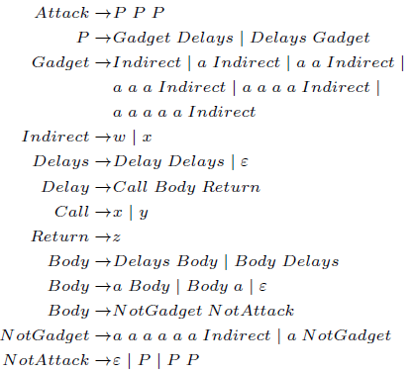
SCRAP Attack Signatures
Symbol | Instruction
w | Indirect Jump
x | Indirect Call
y | Call
z | Return
a | All Other
Signatures with delay gadgets (N=5, S=3):
Attack has 3 parts
Each part has a Gadget and Delays
A Gadget has up to 5 instructions
Delay is a function call
A function call can be a Delay as long as it is not an Attack itself

Slide 22
Example Signatures
Signature | Detected by DROP-like? | Detected by SCRAP?
✔ | ✔
aaawaawaaw
✔ | ✔
awaaxaaaaw
✘ | ✔
awaxaaaaaazaxaw
✘ | ✔
awaxaayaazaaaazaxaw

Slide 23
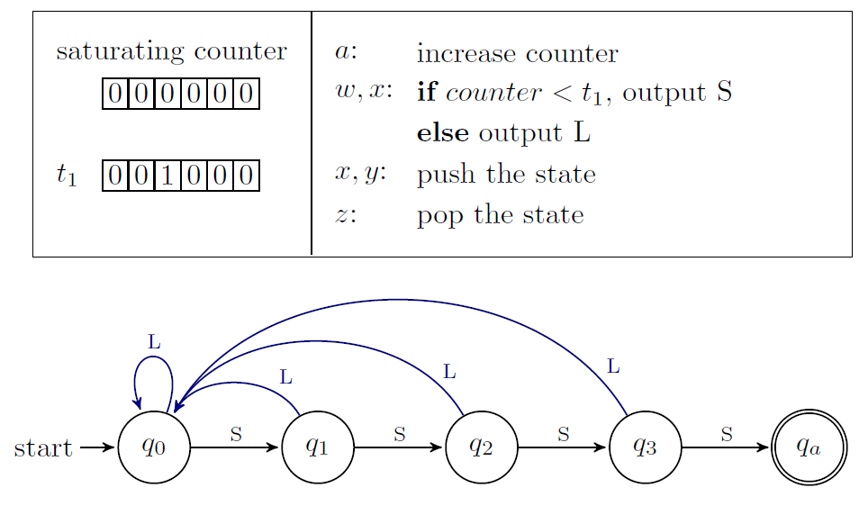
Pushdown Automata

Slide 24
Simple Implementation
Augment the stack of PDA with Secure Call Stack
  Save the PDA state for calls
  Restore for returns
  Modify for indirect jumps
Commit throttling
  Only one stack operation for a commit window
  Negligible slowdown
  Simplifies the circuitry

Slide 25
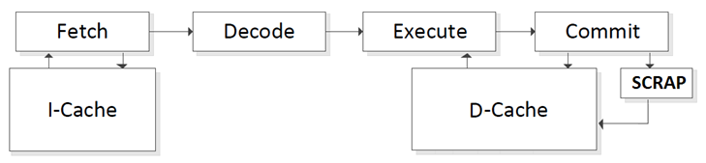
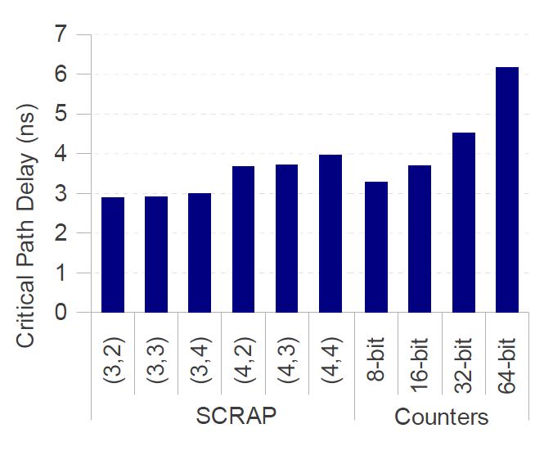
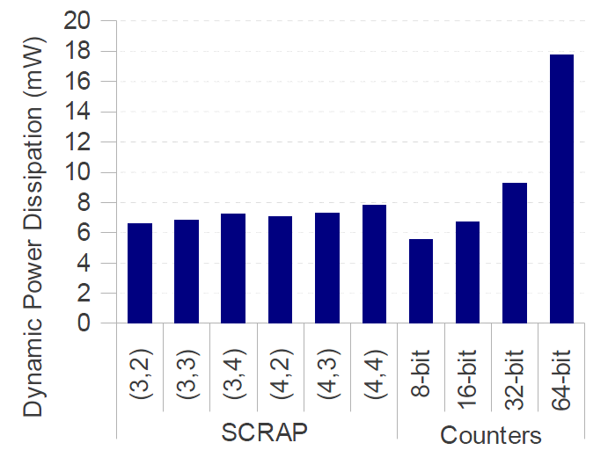
SCRAP Hardware

Slide 26
False Positives for SCRAP
Consecutive Gadgets
CRAs
140 Shell-storm CRA exploits
6
5
4
3
2
1
SPEC 2006 benchmarks
5
6
7
8
9
10
11
12
13
Gadget Length

Slide 27
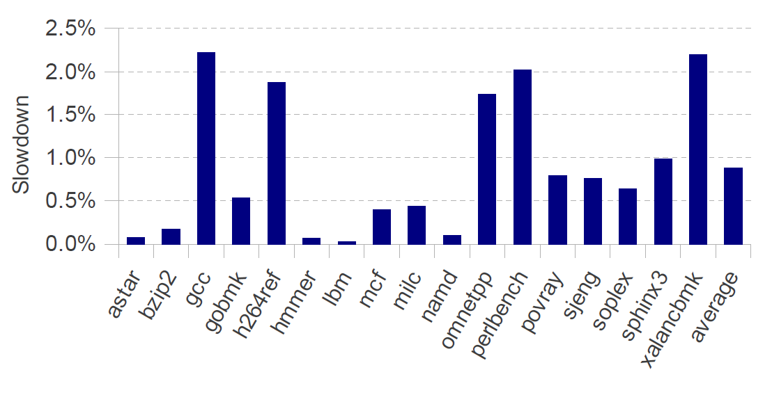
Performance of SCRAP

Slide 28
Conclusions
Signature-based detection of CRAs is promising
  No source code, simple, low-overhead, effective
Naïve approaches can be defeated
  Delay gadgets
We presented SCRAP
  Simple hardware state machine,
  Protects unmodified legacy binaries,
  No changes to software layers,
  Small slowdown: 1% on average
  No false positives

Slide 29
Thank you! Questions?

Slide 30
Backup Slides

Slide 31
Unintended Instructions
Code Snippet from __libc_csu_init function
08048484: E8 33 FE FF FF
08048489: 8D BB 18 FF FF FF
0804848F: 8D 83 18 FF FF FF
08048495: 29 C7
08048484: E8 33 FE FF FF
08048489: 8D BB 18 FF FF FF
0804848F: 8D 83 18 FF FF FF
08048495: 29 C7
FF
8D BB 18 FF FF
call <_init>
lea edi, [ebx-e8h]
lea eax, [ebx-e8h]
sub, edi, eax
FF
8D 83 18 FF FF
FF
29
Unintended Code Snippet from __libc_csu_init function
08048488: FF 8D BB 18 FF FF
0804848E: FF 8D 83 18 FF FF
08048494: FF 29
dec [ebp-e745h]
dec [ebp-e77dh]
jmp [ecx]

Slide 32
Gadget Length
Long gadget means more intermediate instructions

Slide 33
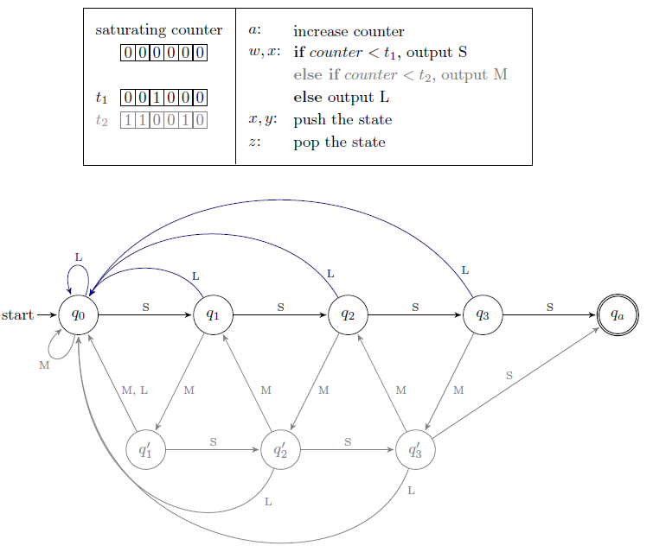
Two threshold SCRAP

